Slide 1

Expense Tracker Project
Presentation of project by group members :-
Roll No Name
78 Vaishnavi Sardar Patil
97 Shraddha Nilesh Sonawane
99 Tejashree Chandrakant Jadhav
100 Vaishnavi Kashinath Gawade
vp

Slide 2
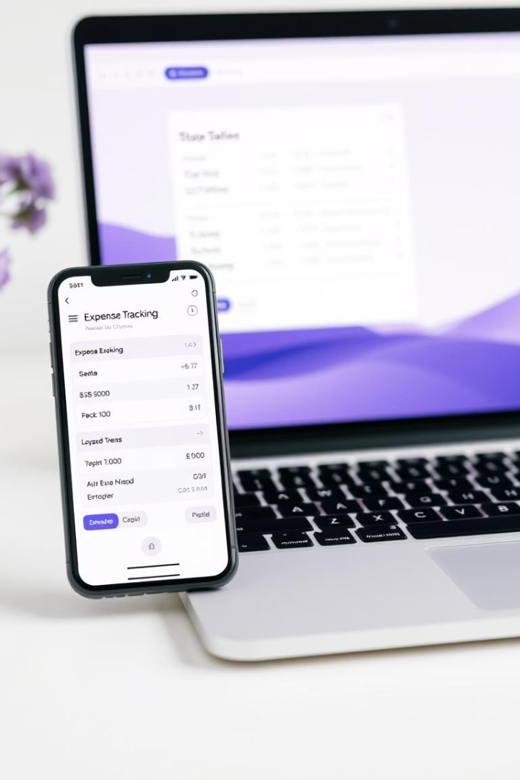
Introduction to Expense Tracker
Purpose of the system
Problem statement
Many people struggle to track their spending effectively, leading to poor financial decisions.
To provide users with a convenient way to record, analyze, and manage daily expenses.
Solution overview
The system uses Java to create an intuitive and secure application that categorizes expenses and provides insights.

Slide 3

Project Objectives
Accurate Expense Recording
Ensure all user expenses are captured precisely with relevant details like date, category, and amount.
Expense Categorization
Automatically group expenses into predefined and customizable categories for better organization.
Report Generation
Provide detailed spending summaries and trends over selected periods to support financial planning.
User Friendly Interface
Create an easy-to-navigate application enabling efficient data entry and retrieval.

Slide 4
System Architecture
Presentation Layer
Business Logic Layer
Data Layer
Handles the user interface and experience, enabling interaction with the system through forms and displays.
Processes data inputs, applies rules for expense categorization, validation, and calculations.
Responsible for storing expense data securely, typically using databases or file systems.

Slide 5





Working of the Expense Tracker System
Input Entry
The user enters expense details including amount, category, and date.
Validation
The system verifies data correctness and completeness before processing.
Processing
Expenses are categorized and stored securely in the system database.
Output & Reports
Users can generate visual reports summarizing their spending behavior over chosen intervals.

Slide 6
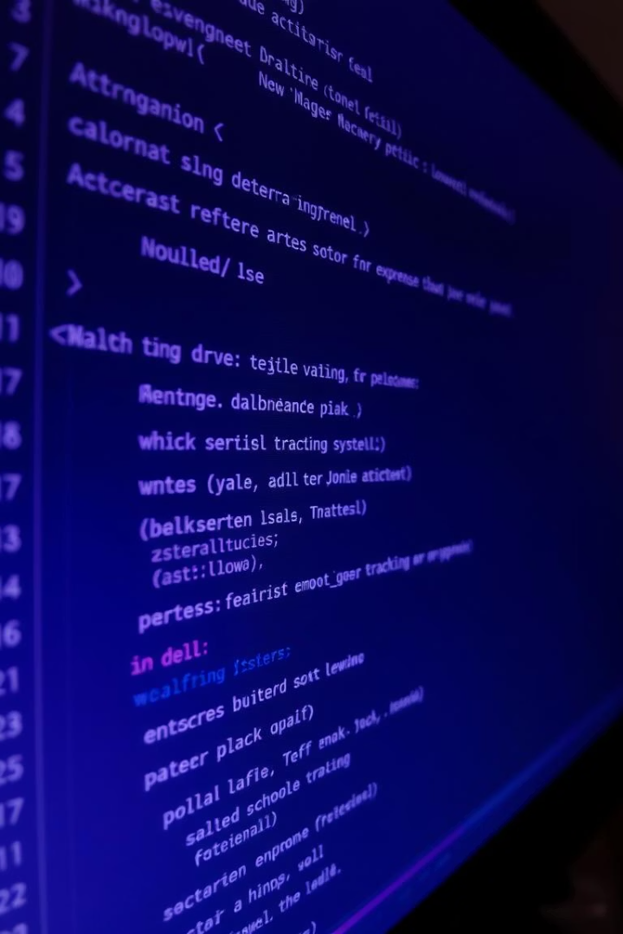
Java Concepts Used in Expense Tracker
Object-Oriented Programming
Use of classes and objects to model expenses, users, and application components, promoting modularity.
Exception Handling
Robust error detection and management ensures smooth user experience and prevents crashes.
File Handling
Persistence of expense records using Java I/O for saving and loading data from files.
Collections Framework
Utilizing lists, maps, and sets to efficiently store and retrieve expense data and categories.

Slide 7
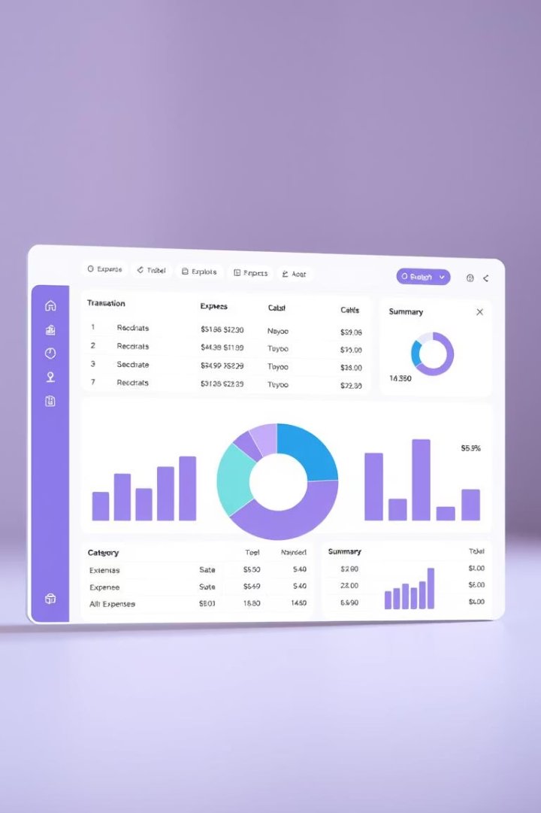
Additional Java Features Enhancing the System
Swing for GUI
Graphical User Interface built with Java Swing provides an interactive and responsive user experience.
JavaFX for Visualization
Dynamic charts and graphs implemented with JavaFX to display expense summaries visually.
Multithreading
Handles background tasks such as data saving and report generation without freezing the UI.
Java Database Connectivity (JDBC)
Integration with databases for scalable and reliable storage of users' financial data.

